Slide 1

Day 1: Arrival Damascus
M zaic
travel & tourism
Arrival to Damascus airport
Continue to Damascus –Pick up the room at the hotel
Overnight at the hotel

Slide 2
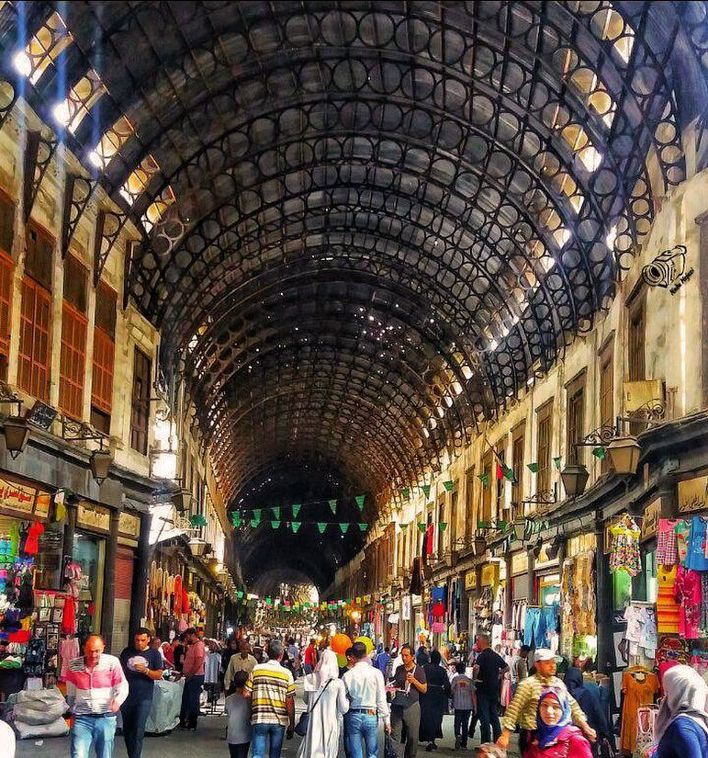
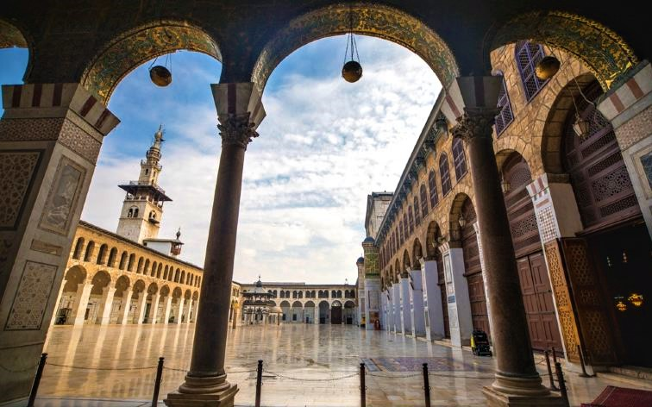
Day 2: Damascus city tour
Start the Damascus city tour
Founded in the 3rd millennium B.C., Damascus is o the oldest capital inhabited in the world. In the Middle Ages, it was the center of a flourishing craft industry, specializing
The Umayyad Mosque :
Located in the heart of the Medina, the mosque is distinguished by its prayer room, its courtyard and its walls covered with mosaics.
M zaic
travel & tourism
Souk Al-Hamidiye : The most beautiful souk of Damascus. Its shops display all sorts of goods, especially clothes, fabrics, pastries and handicrafts.

Slide 3
El-Azem Palace: Not far from the Great Mosque, in the labyrinth of the souk is the palace El-Azem. It is considered as the sumptuous model of the Damascene house whose exterior simplicity and sobriety do not suggest anything about a beautiful and rich interior, with many varieties of flowers, fruit trees and water jets.
Caravanserai is the largest caravanserai (khān) in the Old City of Damascus. Situated along Al-Buzuriyah Souq, it was built in 1751. Khan As'ad Pasha has been described as one of the finest khans of Damascus, and the most "ambitious" work of architecture in the city.
M zaic
travel & tourism
Straight Street (or in Latin, Via Recta), is the Roman street that runs from east to west in the old city of Damascus. It was visited by St. Paul as recorded in the book of Acts of Apostles and contains several interesting sights from the Roman, Christian and Islamic periods. Under the Greeks, the old city of Damascus was designed after the grid pattern designed by Hippodamus. Under Roman rule, the Via Recta was widened and became a colonnaded thoroughfare (documanus). These columns can still be seen today
Saint Ananian Church: It is of particular importance because it is attached to the memory of Saint Paul. Before his conversion to Christianity he had a vision here that blinded him for several days and gave him an unshakeable faith.
In the afternoon, you will explore Damascus’ old town, free time.
Over night at the hotel

Slide 4
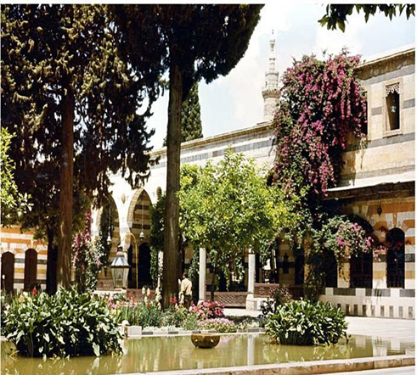
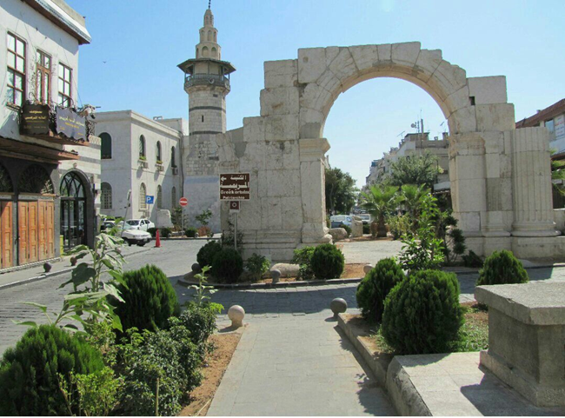
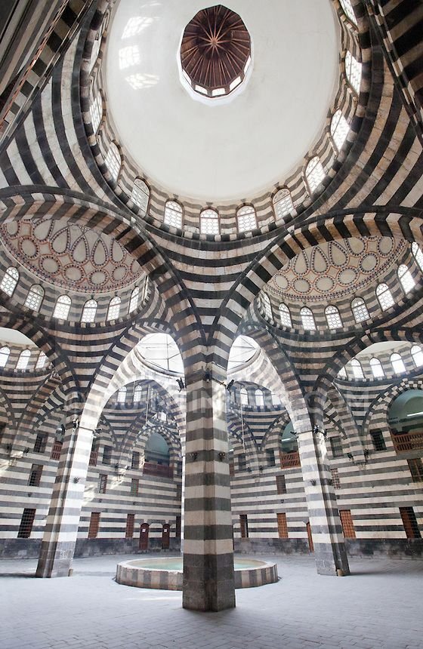
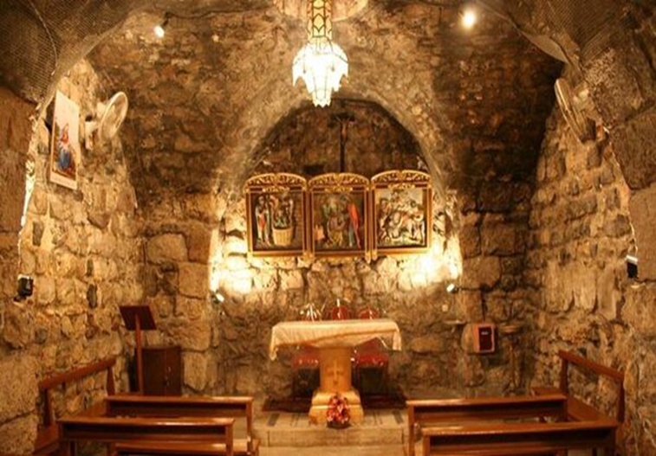
Azem Palace
Straight Street
caravanserai
M zaic
travel & tourism
Anania Church

Slide 5
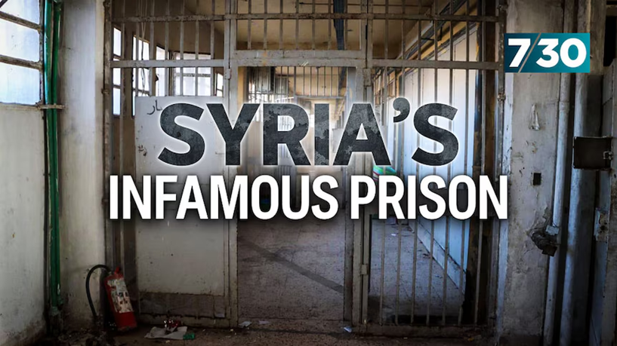
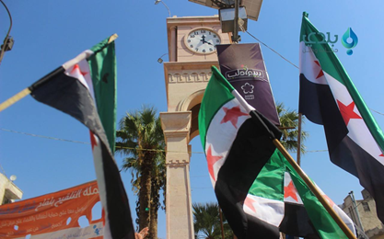
Day 3: Damascus – Sednaya Prison-Idlib-Dead cities
Breakfast at the hotel .
Departure to Saydnaya Military Prison: is located 30km north of Damascus, Syria. The prison became notorious for the use of torture and excessive force for both peaceful opponents of the authorities as well as military personnel suspected of opposing the regime.
M zaic
travel & tourism
Continuation to Idlib city : is one of the first Syrian governorates to rise up against Bashar al-Assad's regime in 2011
It was the stronghold of the Syrian opposition that overthrew the Assad regime

Slide 6
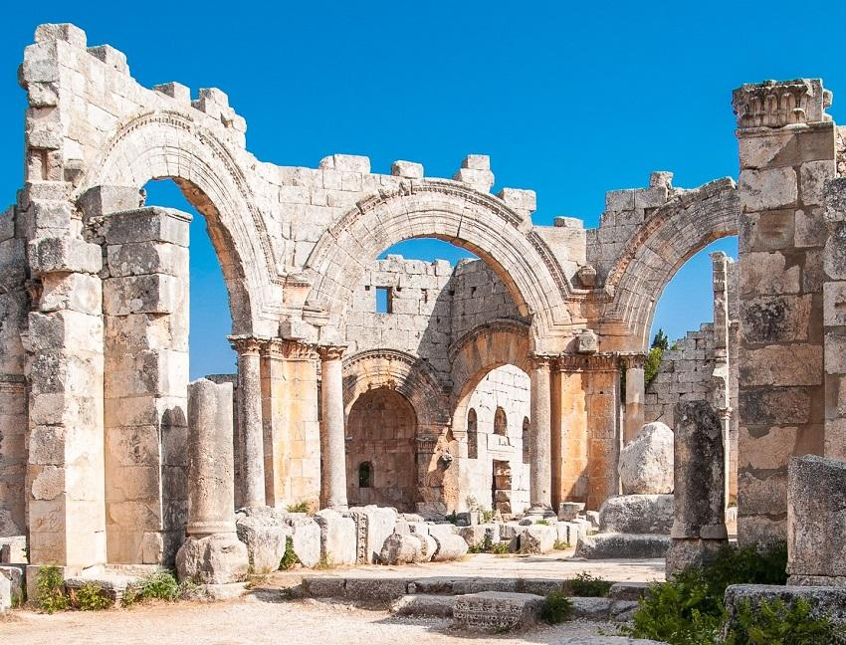
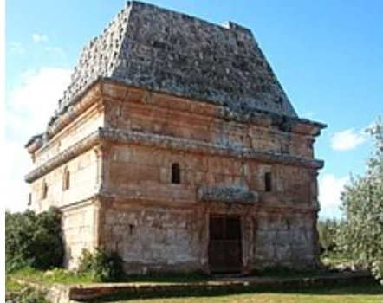
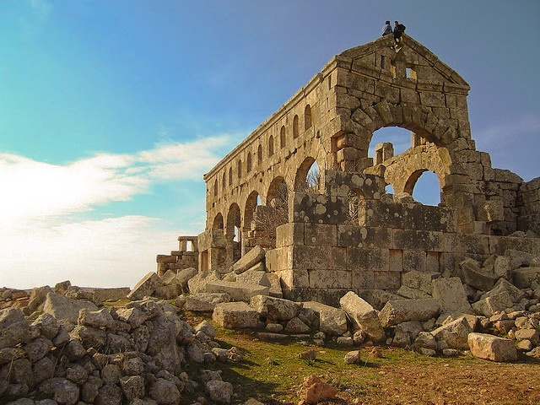
Day 2: Damascus – Sednaya Prison-Idlib-Dead cities
Dead cities: Its construction dates back to the period between the first and seventh centuries AD, and sometimes until the tenth century, and it is one of the important areas in the history of Christianity, the most important is: St. Simeon Church - Barad - Al-Bara - Qalb Lozeh - Sergila.
M zaic
travel & tourism

Slide 7
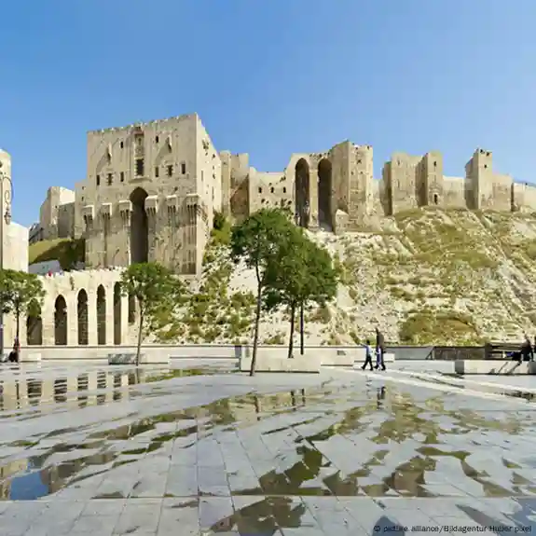
Day4: Aleppo
Breakfast at the hotel .
Visit of the second city of Syria.
A flourishing metropolis since the 3rd millennium BC, Aleppo has been compete with Damascus for the title of the world’s oldest continuously inhabited city. The old city has undoubtedly the most beautiful souks of the Middle East.
M zaic
travel & tourism
The citadel: stands in the middle of the city and dominates it from the height of its fifty meters. It has admirably designed towers and is distinguished by its entrances made with perfection to prevent any enemy intrusion and its iron gates.

Slide 8
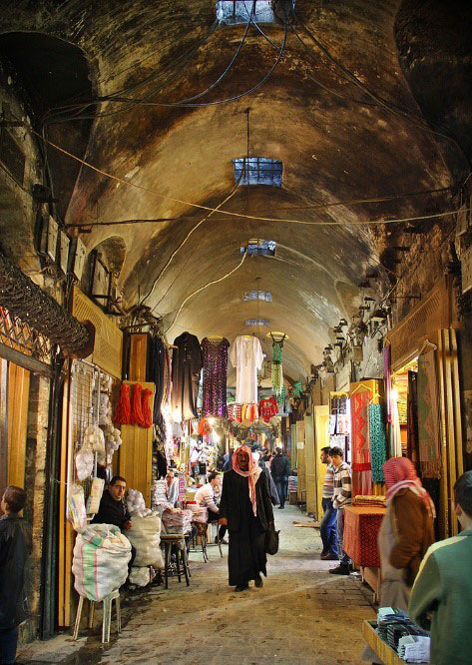
Aleppo
The souks: The old souks covered in Aleppo are distinguished by their coffered vaults and their enormous cupolas. Most date back to the 15th and 16th centuries. These are real living museums that offer us a true image of what were the commercial districts and the animation that reigned in the Middle Ages.
Each souk specializes in selling a type of product. In the charming souks you can also find authentic Bedouin handicrafts, as well as rugs, fabrics and many varieties of delicacies to enjoy, such as the famous Aleppo pistachios, honey-based pastries, almonds and fruits. dry that will make happy the most greedy. You will do the best shopping in the Orient …
M zaic
travel & tourism

Slide 9
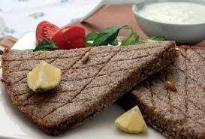
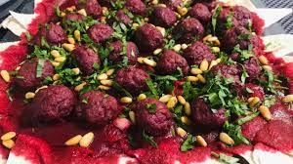
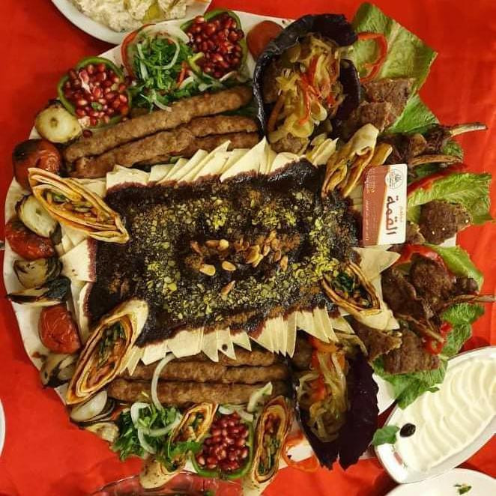
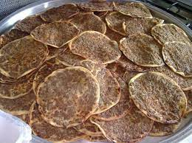
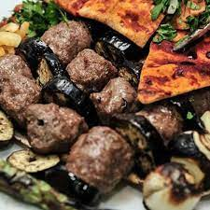
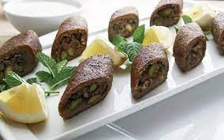
We taste food in Aleppo

Slide 10
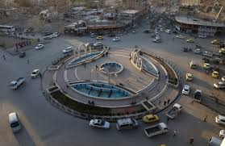
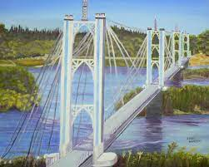
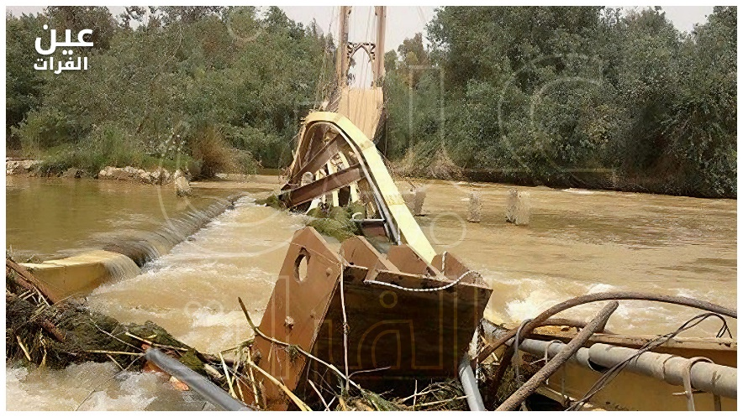
Day 5: Aleppo-Raqqa-Deir Ezzor
Breakfast at the hotel .
Departure to Raqqa: is among the Syrian cities that witnessed the worst types of destruction during the crisis.
After armed groups took control of it in 2013. At the beginning of 2014, ISIS was able to tighten its control over the city and make it its capital.
M zaic
travel & tourism
Continuation to Deir Ezzor :in eastern Syria is a region that has witnessed a turbulent history since the beginning of the Syrian revolution in 2011, as it is a critical intersection point in the Syrian conflict where multiple interests converge, including those related to the Syrian Democratic Forces and local tribes.
Now
Before

Slide 11
Day 6: Deir Ezzor-Palmyra-Damascus
Breakfast at the hotel. Departure to Palmyra: The one that the Romans baptized Palmyra (the city of palms) and that the Syrians call Tadmor (miracle in Aramaic) is the most important oasis of the Syrian Desert. Located 240 km from Damascus, Palmyra is the city of all superlatives.It arises in the midst of golden sands that extend to infinity. An oasis of columns remains and palm trees that testifies to the splendor of this city that made, one day, tremble Rome.
• The temple of Bel: It was for the Palmyrens what Zeus was for the Greeks. Its temple is the largest and most majestic building in Palmyra, a unique example of fusion between Greco-Roman and oriental-
inspired architecture.
• The theater and the big colonnade: It crosses the city on more than one kilometer by which the caravans arriving from the desert passed by.
• Tombs: including towers tombs, tombs underground, Temple tombs and individual tombs.
• Back to Damascus – Dinner and overnight at the hotel.
M zaic
travel & tourism

Slide 12
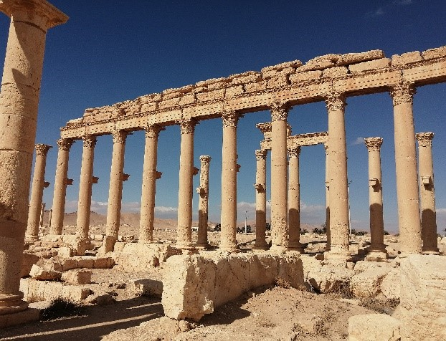
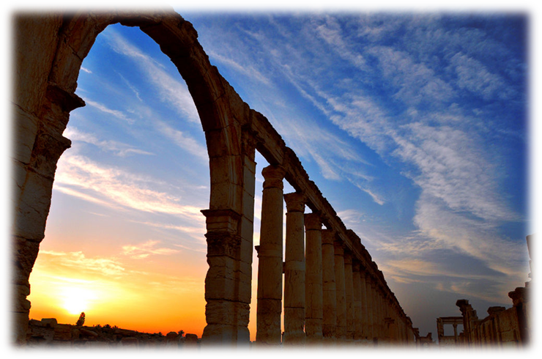
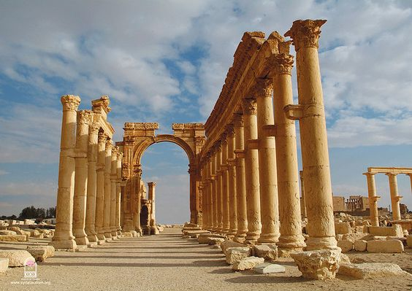
M zaic
travel & tourism

Slide 13
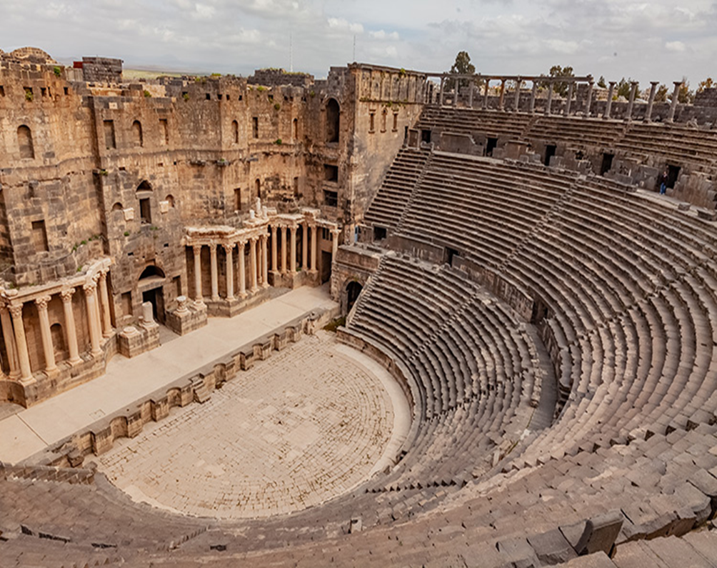
Day 7: -Damascus-Bosra-Shahba-Kanawat-Sweida-Damascus
Breakfast at the hotel. Departure to Bosra:
Bosra: a very ancient city, already mentioned in the inscriptions of Akhenaton, in the 14th century BC. The most important of its monuments is the famous Roman theater (2nd century AD), the one of the most beautiful and best preserved in the world. It is 45 meters long and has a depth of 8 meters. It can accommodate seventeen thousands spectators.
M zaic
travel & tourism
Shahba:Famous for its mosaics and monuments dating from the 3rd century A.D., Shahbais thought to be the only town in Syria the Romans built from scratch and one of the most important architectural legacies of their rule in the East.

Slide 14
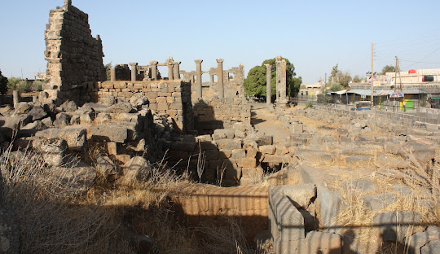
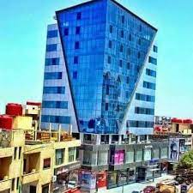
Day 7: -Damascus-Bosra-Shahba-Kanawat-Sweida-Damascus
Kanawat :One of the oldest cities in the world has its monuments destroyed
The Druze reconstructed it and it became a thriving metropolis
Because of its importance, the Romans minted money in its name, but it disappeared After the Caliphate moved to Baghdad and trade routes were diverted from it
M zaic
travel & tourism
Sweida:is an important historical symbol of resistance and revolutions in the region. The majority of its population consists of the Druze community, where the Druze constitute about 90% of the population.
• Back to Damascus
Departure to Beirut

Slide 15
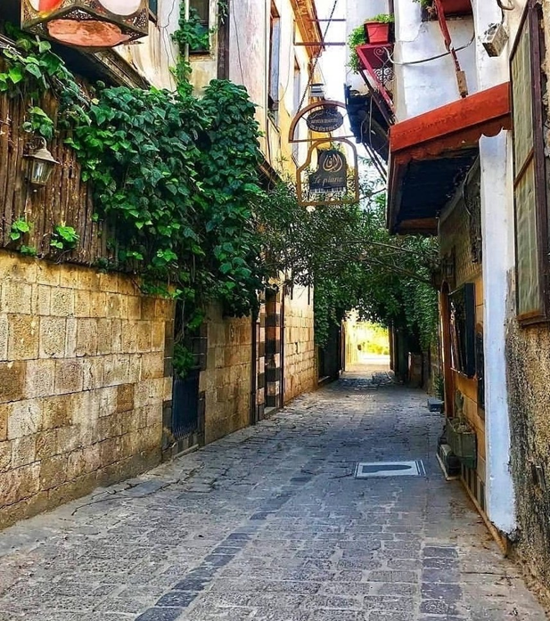
Day 8: Damascus- Departure
M zaic
travel & tourism
Breakfast at the hotel .
Transfer to Damascus airport according the schedule flight

Slide 16
Itinerary
Day 1: Arrival to Damascus airport- Meet the guide to achieve all process-continuation to Damascus-O/ N.
Day 2: Damascus- (Old city-Joubar-Zamaka- Erbin)O/N
Day 3:Damascus-Sednaya prison (depend on permission)Idlib-Dead cities--Aleppo-O/N
Day 4:Aleppo–O/N
Day 5 : Aleppo-Raqqa- Deir Ezzor-O/N
Day 6 :deir Ezzor-Palmyra-Damascus-O/N
Day 7: Damascus-Bosra-Shahba-Kanawat-Sweida-Damascus-O/N
Day 8 : Departure
M zaic
travel & tourism

Slide 17
The price includes:
Accommodation in the hotel mentioned above or similar.
Breakfast.
2 Transfers (Damascus airport– Damascus / Damascus – Damascus airport)
Transport by tourist A/C vehicles .
Guide English speaking.
Approvals for visit and visa.
Entrance fees for all sites in Syria.
1 free of charge in Twin room
Departure tax.
Assistance 24/24 on mobile phone, in Syria (+963988 265 319 ).
The price does not include:
Drinks.
Lunch
Diner
Cost of visa in Syrian borders
Personal expenses.
M zaic
travel & tourism

